Slide 1


Beyond Metadata for BBC iPlayer
An autoencoder-DRIVEN APPROACH FOR EMBEDDING GENERATION IN CONTENT SIMILARITY RECOMMENDATIONs
Simone spaccarotella
18TH NOVEMBER 2024

Slide 2
Beyond Metadata for BBC iPlayer
An autoencoder-DRIVEN APPROACH FOR EMBEDDING GENERATION IN CONTENT SIMILARITY RECOMMENDATIONs

Slide 3
Introduction
Who I am and what my technical background is

Slide 4



Introduction

Slide 5

Area of Research

Slide 6
Project ideas
Use of Contextual Data in personalized recommendations
Play pattern and interaction pattern analysis
Sequential recommender system
Use of Passport tags to improve recommendations
Item representation with Autoencoders
Multi-product recommendations

Slide 7
Project ideas
Use of Contextual Data in personalized recommendations
Play pattern and interaction pattern analysis
Sequential recommender system
Use of Passport tags to improve recommendations
Item representation with Autoencoders
Multi-product recommendations

Slide 8
Project ideas
Use of Contextual Data in personalized recommendations
Play pattern and interaction pattern analysis
Sequential recommender system
Use of Passport tags to improve recommendations
Item representation with Autoencoders
Multi-product recommendations

Slide 9
Project Overview
a high-level summary of the main aspects of the project

Slide 10
What I built
A machine learning pipeline
content-to-content (C2C) similarity recommender
video-on-demand (VOD)
"More Like This" section on BBC iPlayer

Slide 11
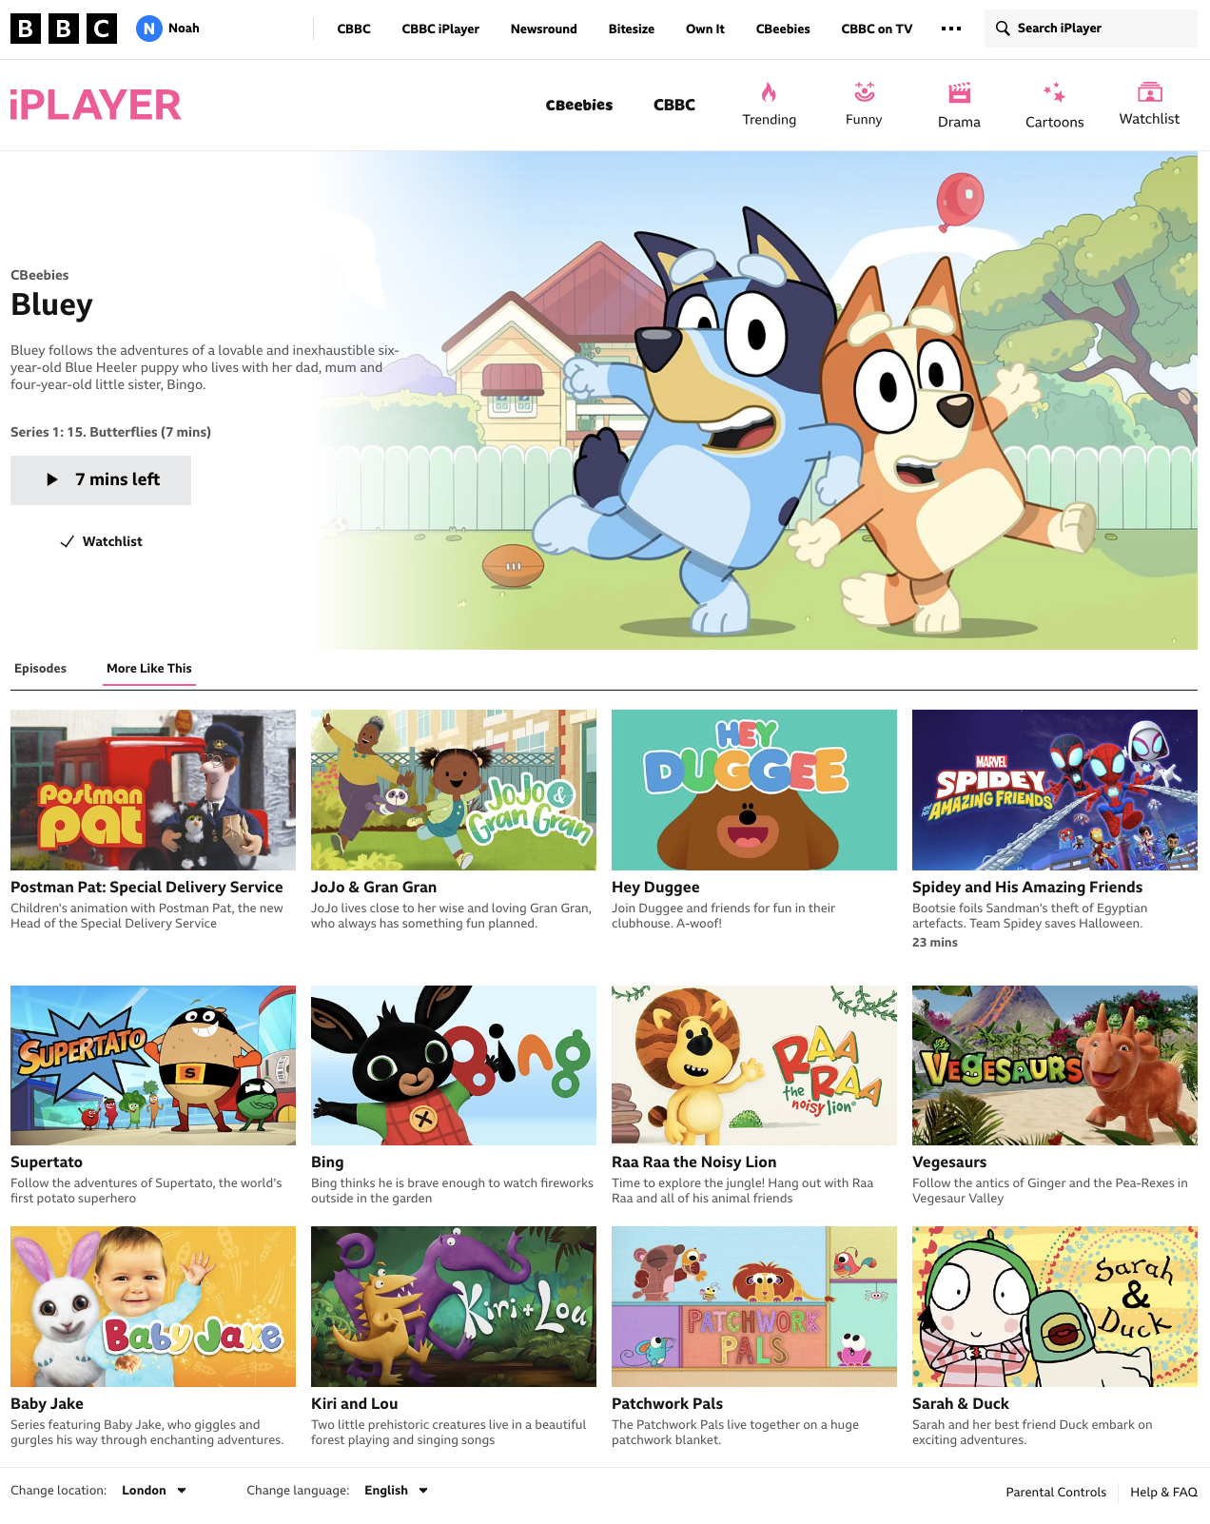
“More like this”

Slide 12
Why this project?

Slide 13
Potentials
Improve the quality of the recommendations
Provide a common embeddings generator for content metadata
Reduce costs and duplications
The what

Slide 14
Contributions
Ingested a feature-rich dataset that better describe the content
Applied novel techniques to improve the descriptive power of the transformed content metadata
The how

Slide 15
Motivations
Improve on the identified issues
Learn and apply novel ML techniques
Align with the business objectives and needs
The why

Slide 16
Issues with the current solution
Feature poor
Lack of preprocessing
Suboptimal similarity scoring
Hardcoded parameters

Slide 17
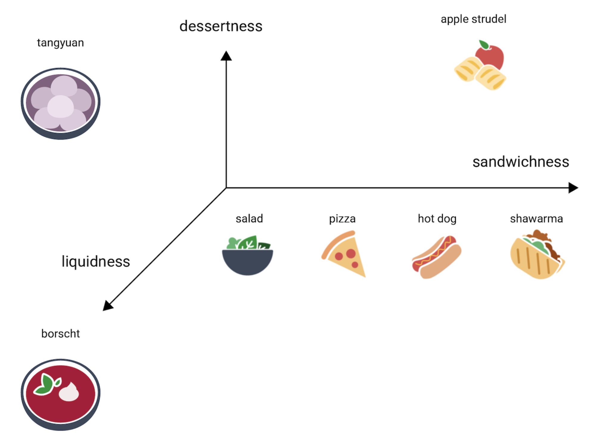
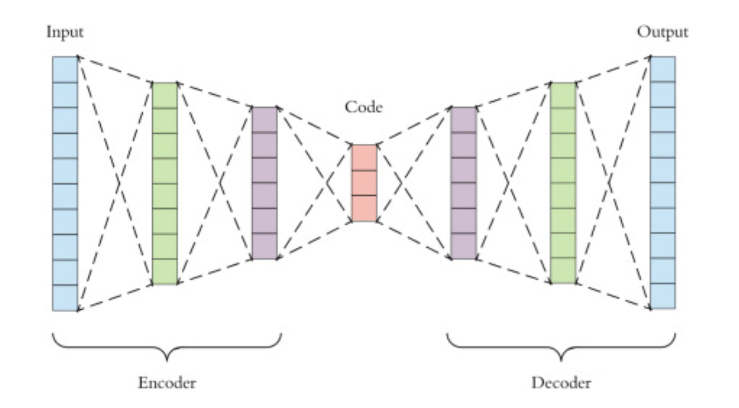
Techniques

Slide 18
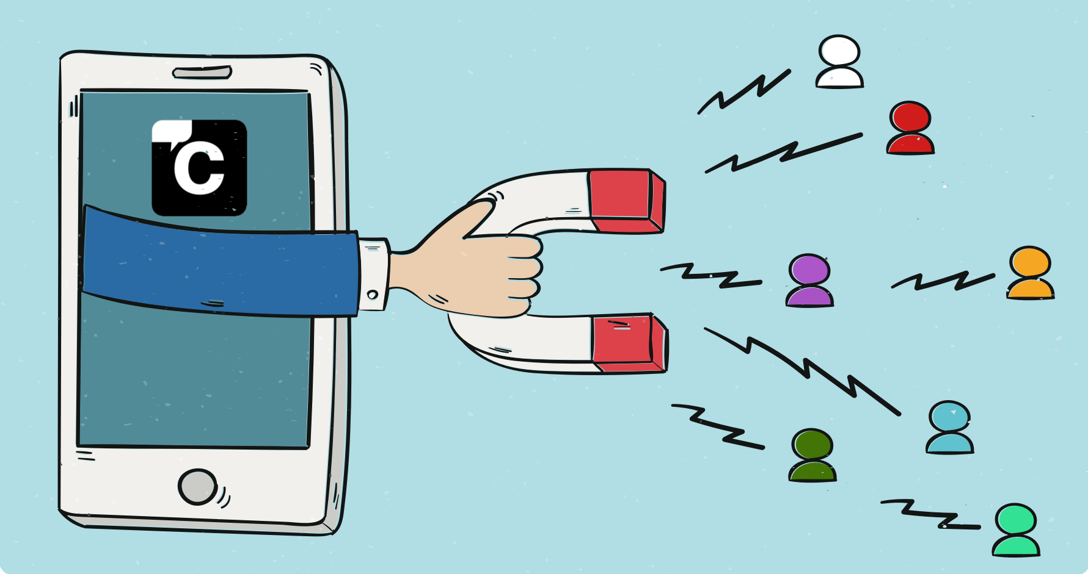


Business Objectives and Needs

Slide 19
Measure of Success
Key performance indicators and scope of the project

Slide 20
Key Performance Indicators
Integration with Passport Tags
Comparability of the recommendations with the current solution

Slide 21

Business Objectives and Needs

Slide 22
Cost Reduction

Slide 23
Potential cost reduction
C
/
Linked to the Passport integration and adoption of the solution
N

Slide 24
User Engagement

Slide 25
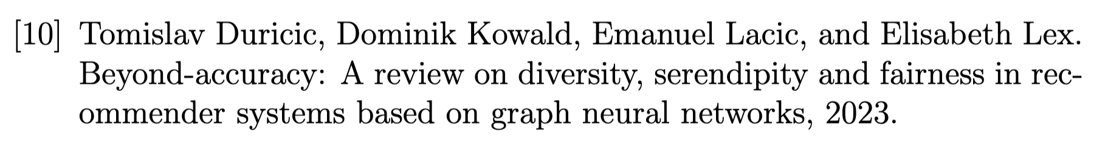
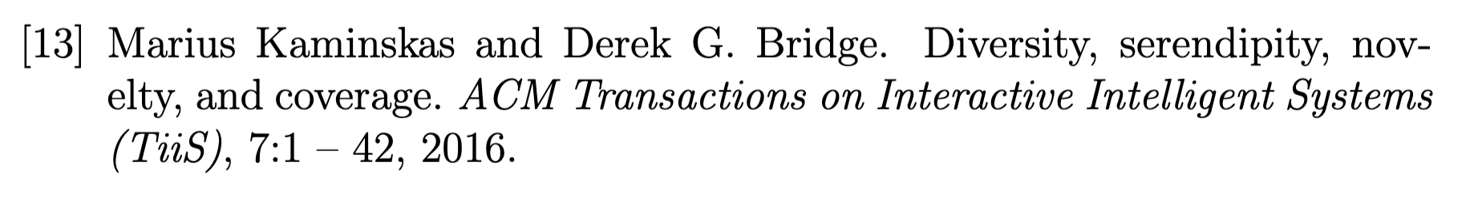
User Engagement

Slide 26

Diversity
A Measure of variety within similarity recommendations

Slide 27
Diversity
Metadata Variety
Genre
Format
Contributor
Motivation
Editorial Tone
Narrative Theme
A Measure of variety within similarity recommendations
Relevant To
About

Slide 28

Diversity
A Measure of variety within similarity recommendations

Slide 29

Out of Scope
A/B test experimentation

Slide 30
In Scope
Proprocess the data
Train and validate a model
Generate and visualize the recommendations
Build an MVP
Share the results with stakeholders

Slide 31
The Main Intuition
The idea behind the project

Slide 32

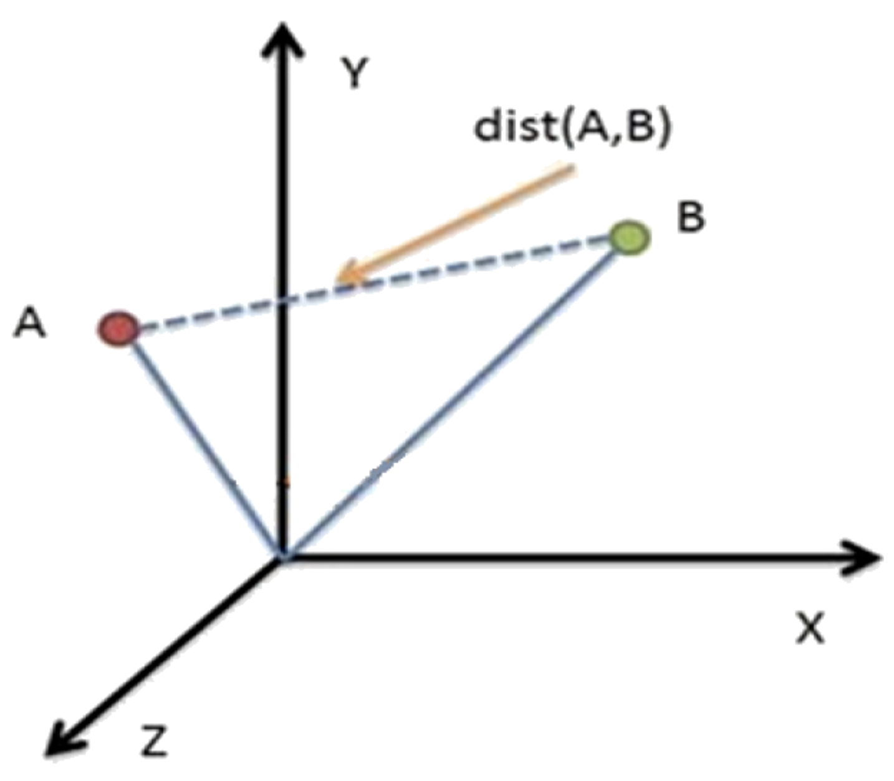
The Main Intuition
Similarity
Distance in space

Slide 33
The Data
An overview of the iPlayer catalogue and the data structure

Slide 34
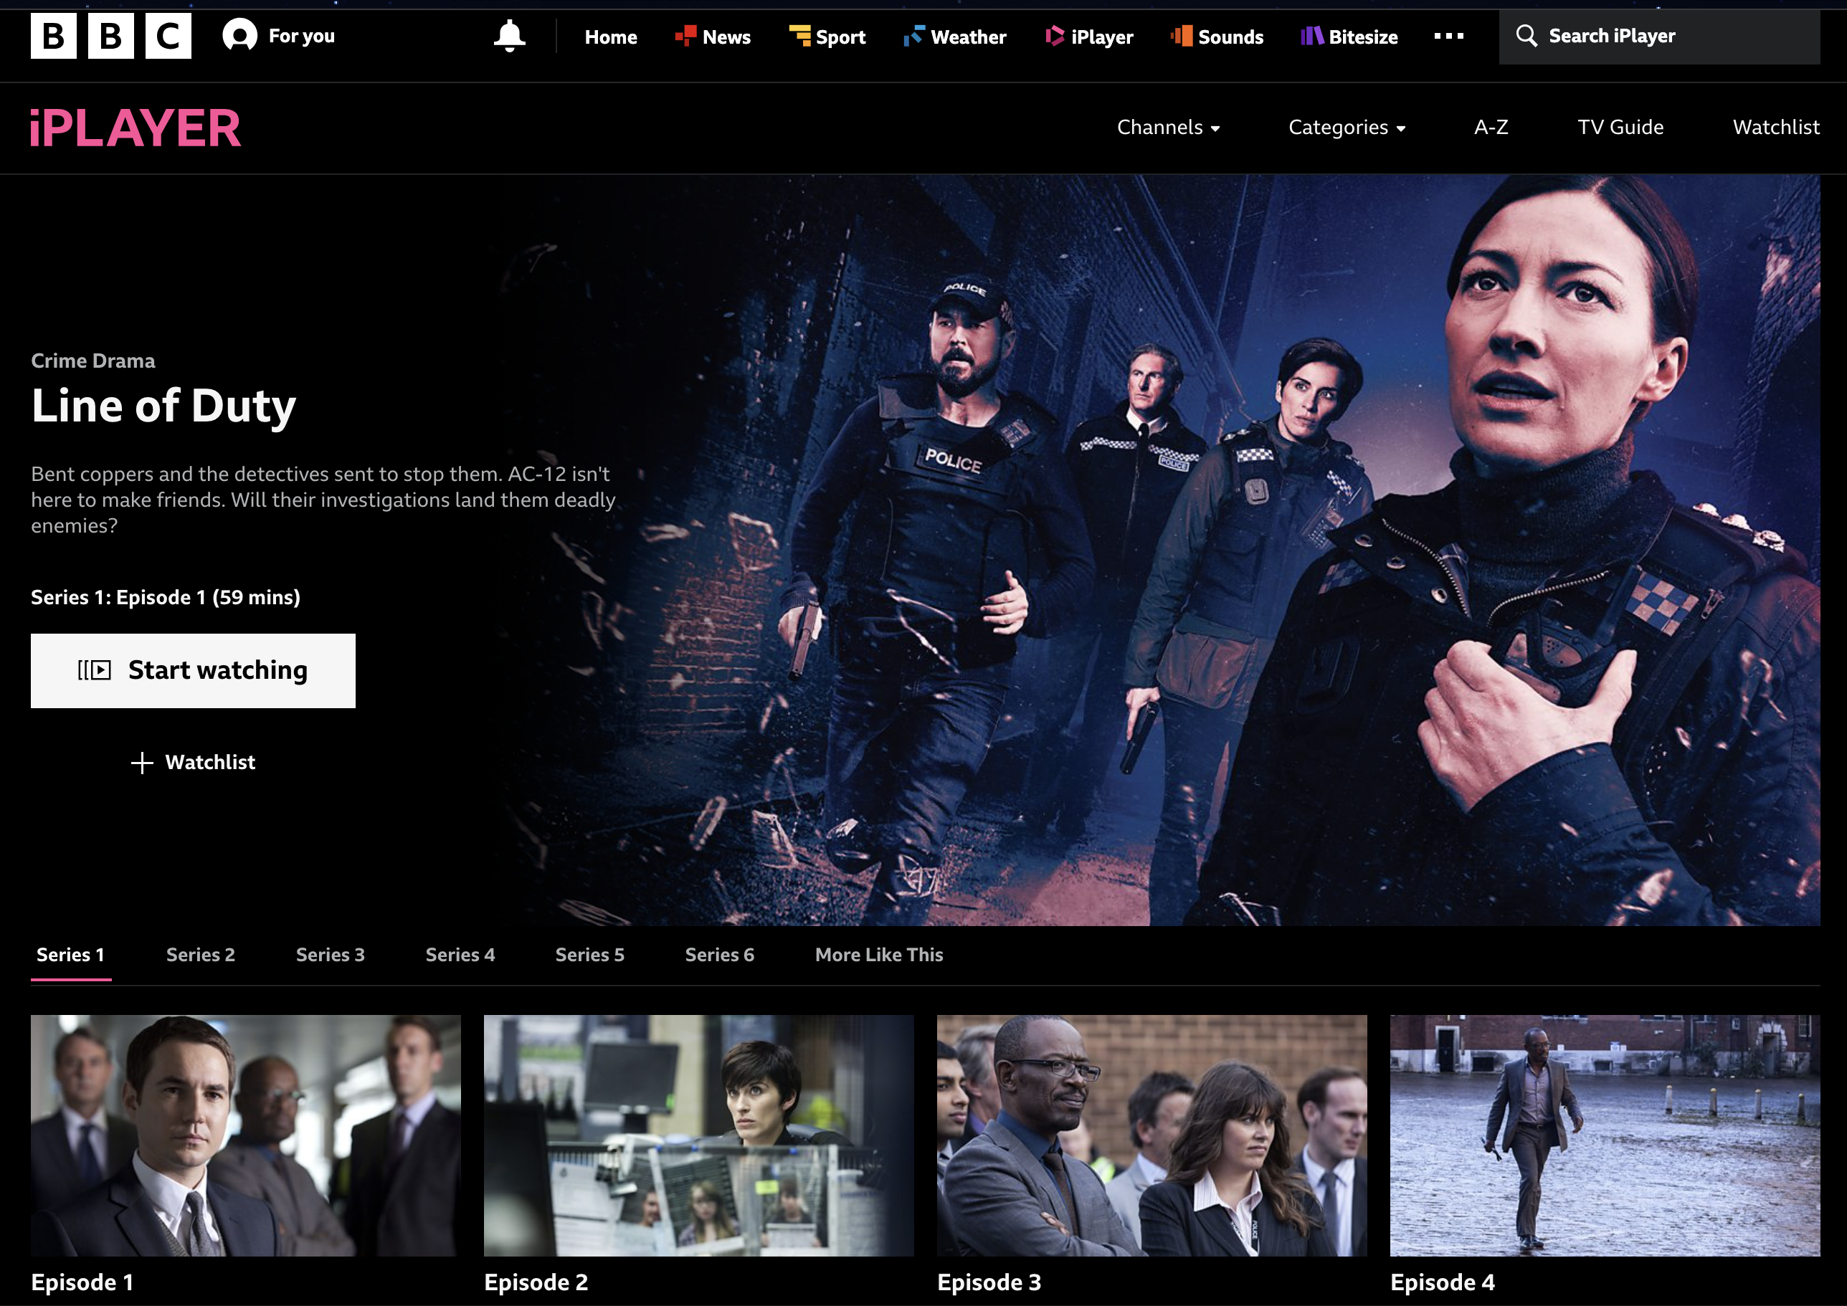
Main Idea

Slide 35

Main Idea

Slide 36
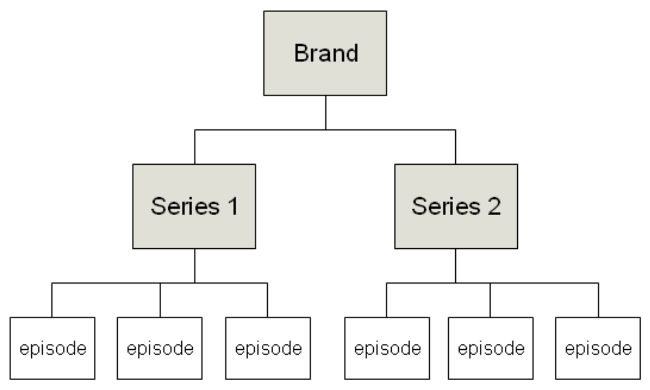
The Data
iPlayer Programmes Structure

Slide 37
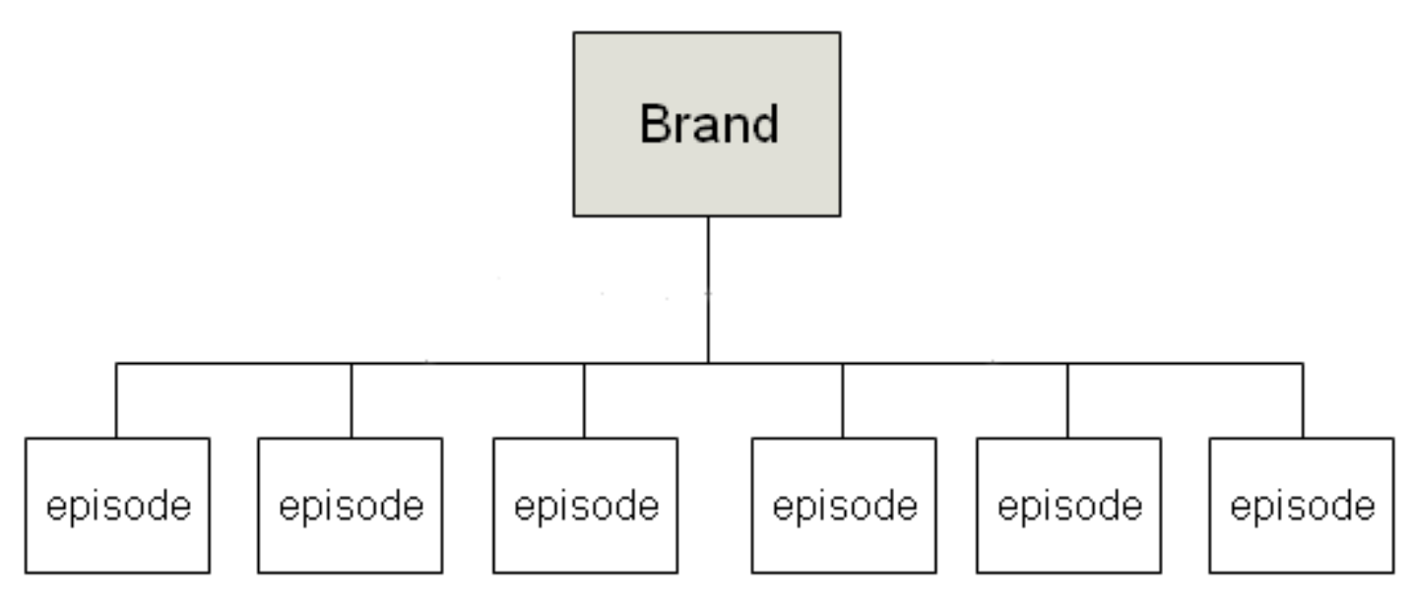
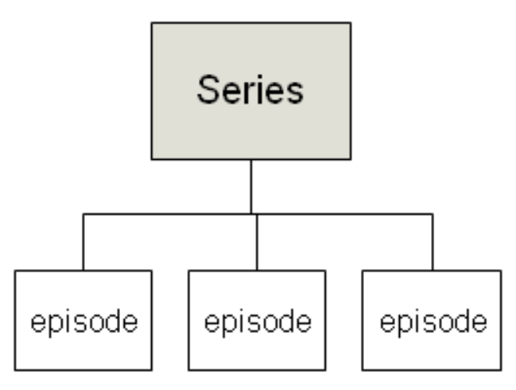
The Data
iPlayer Programmes Structure

Slide 38
The Data
episode
iPlayer Programmes Structure

Slide 39
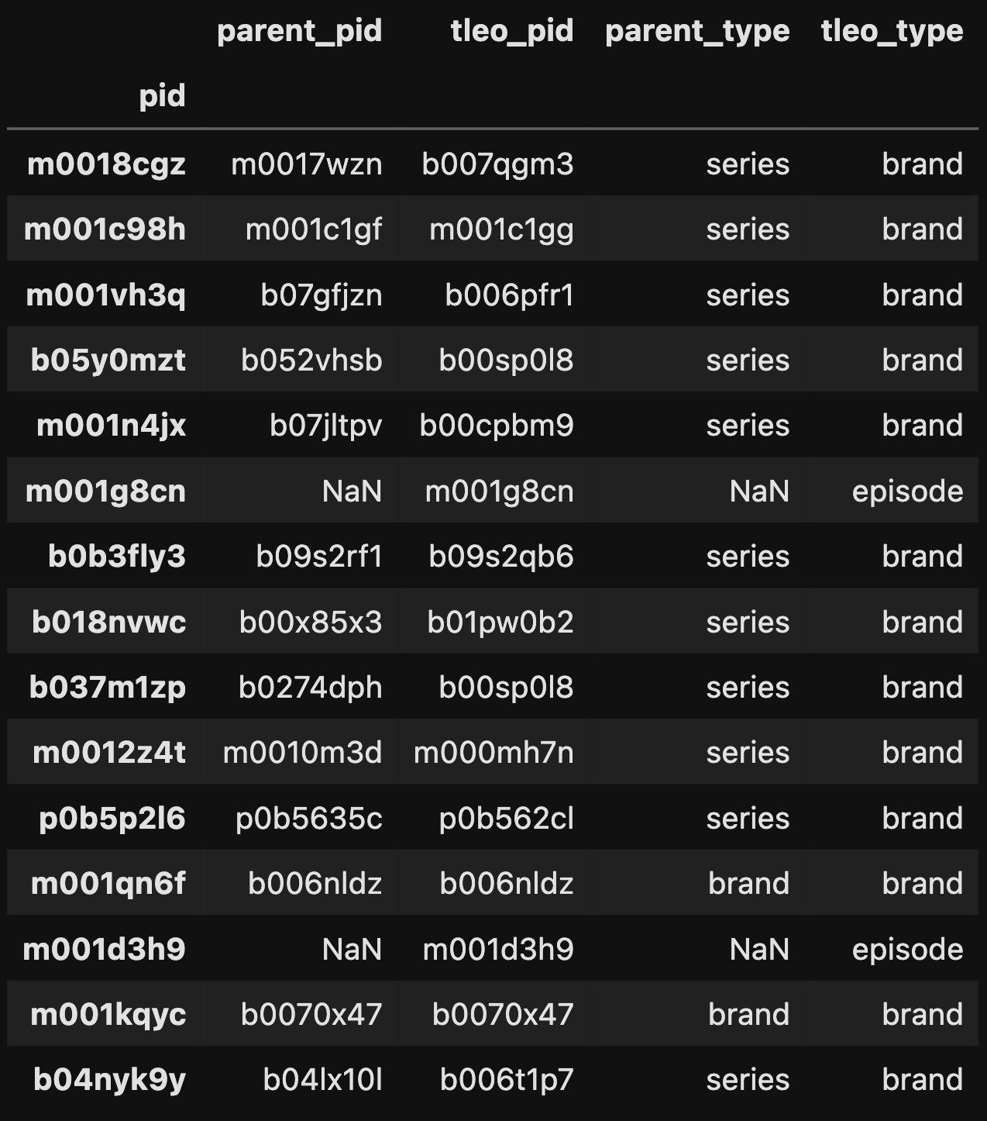
The Data
The iPlayer Catalogue

Slide 40
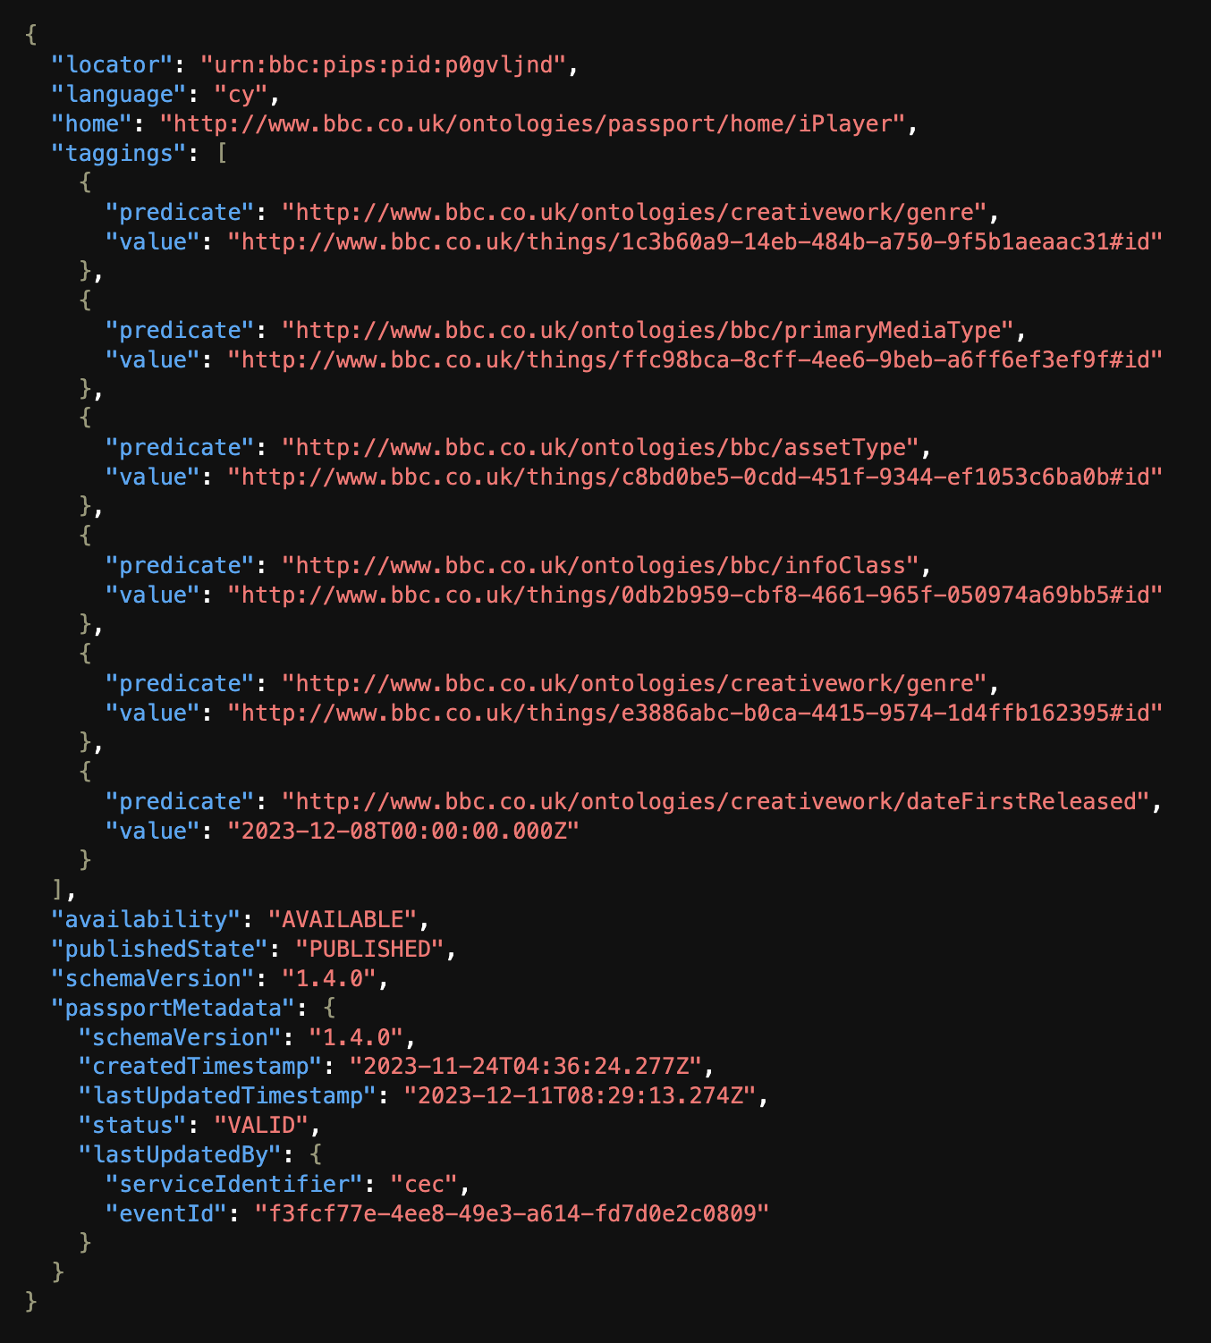
The Data
The Passport Tags

Slide 41
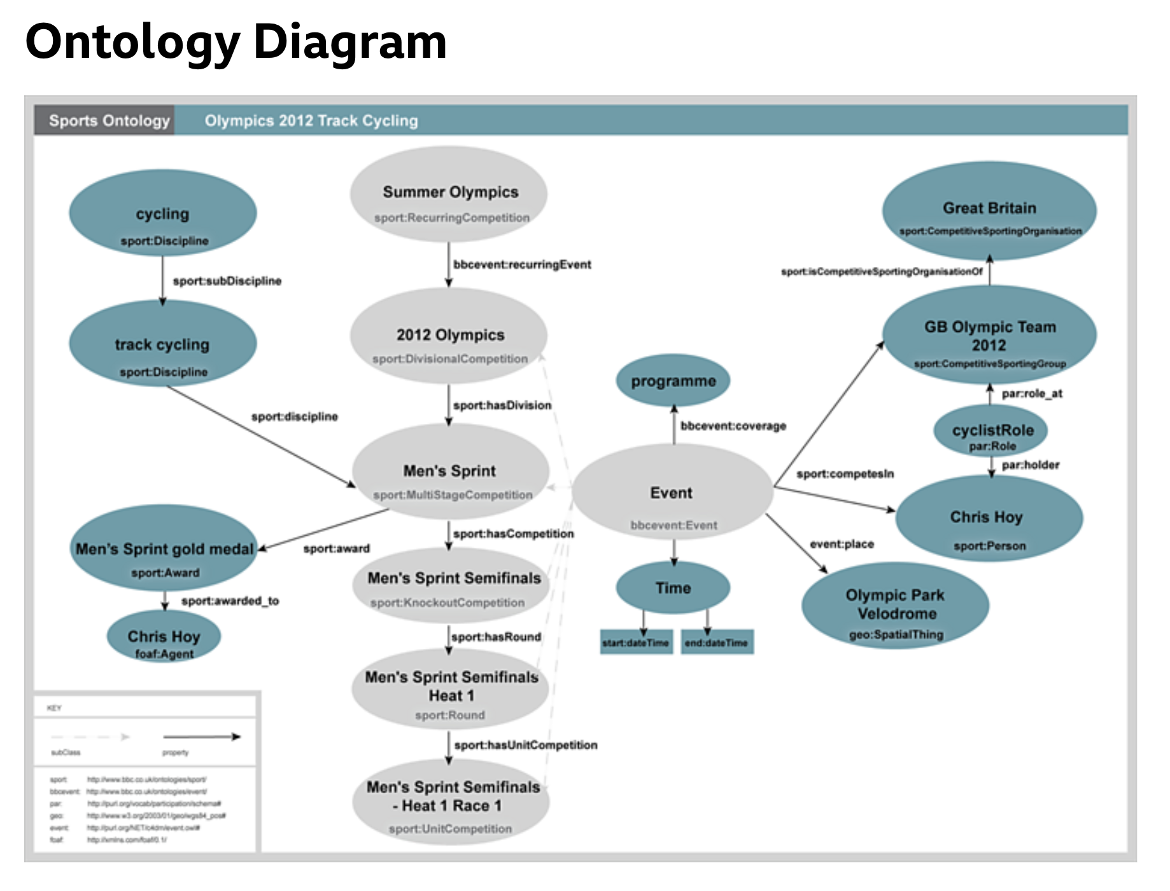
The Data
The BBC Ontologies

Slide 42
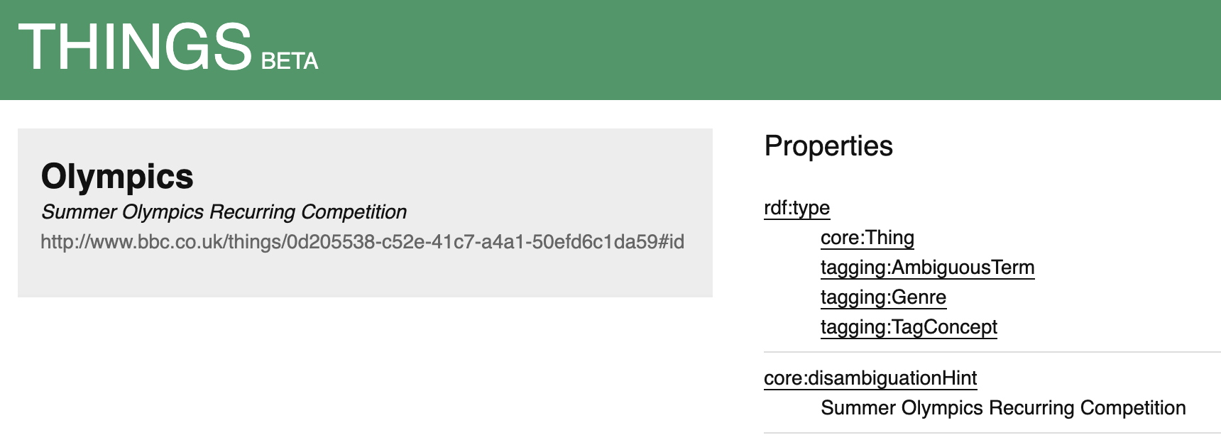
The Data
The BBC Things entities

Slide 43
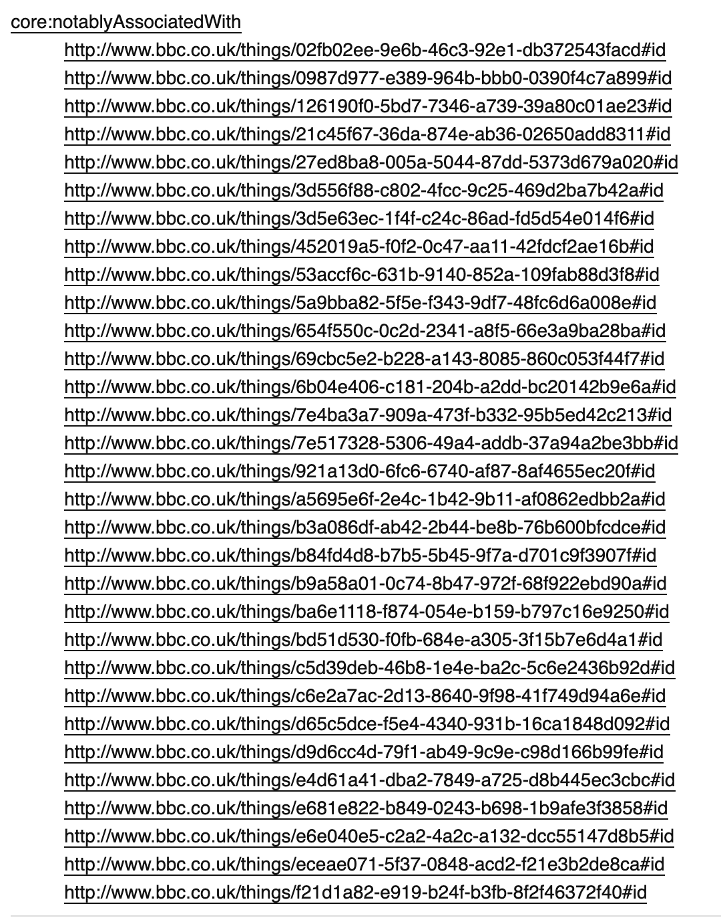
The Data
The BBC Things entities

Slide 44
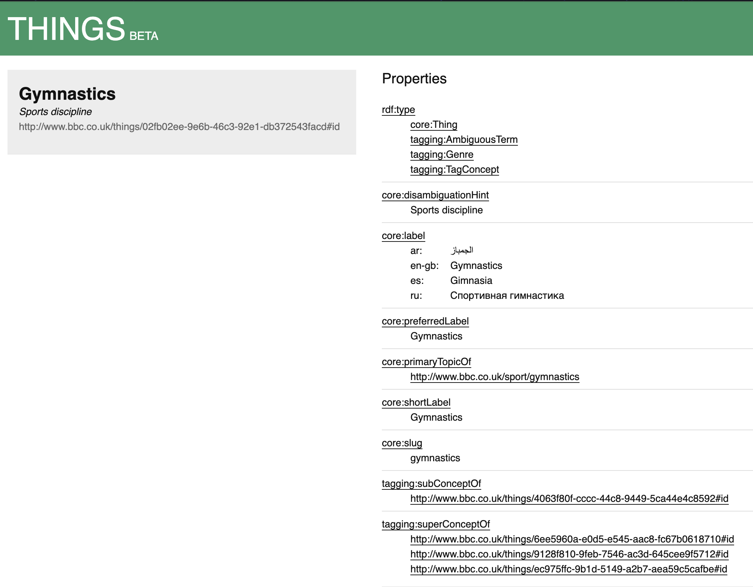
The Data
The BBC Things entities

Slide 45
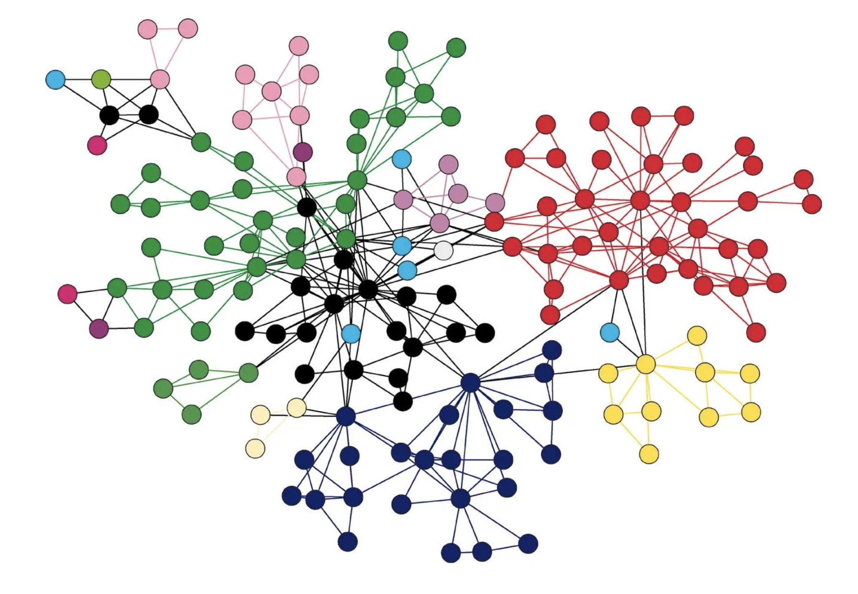
The (Linked) Data
Graph Data Structure

Slide 46
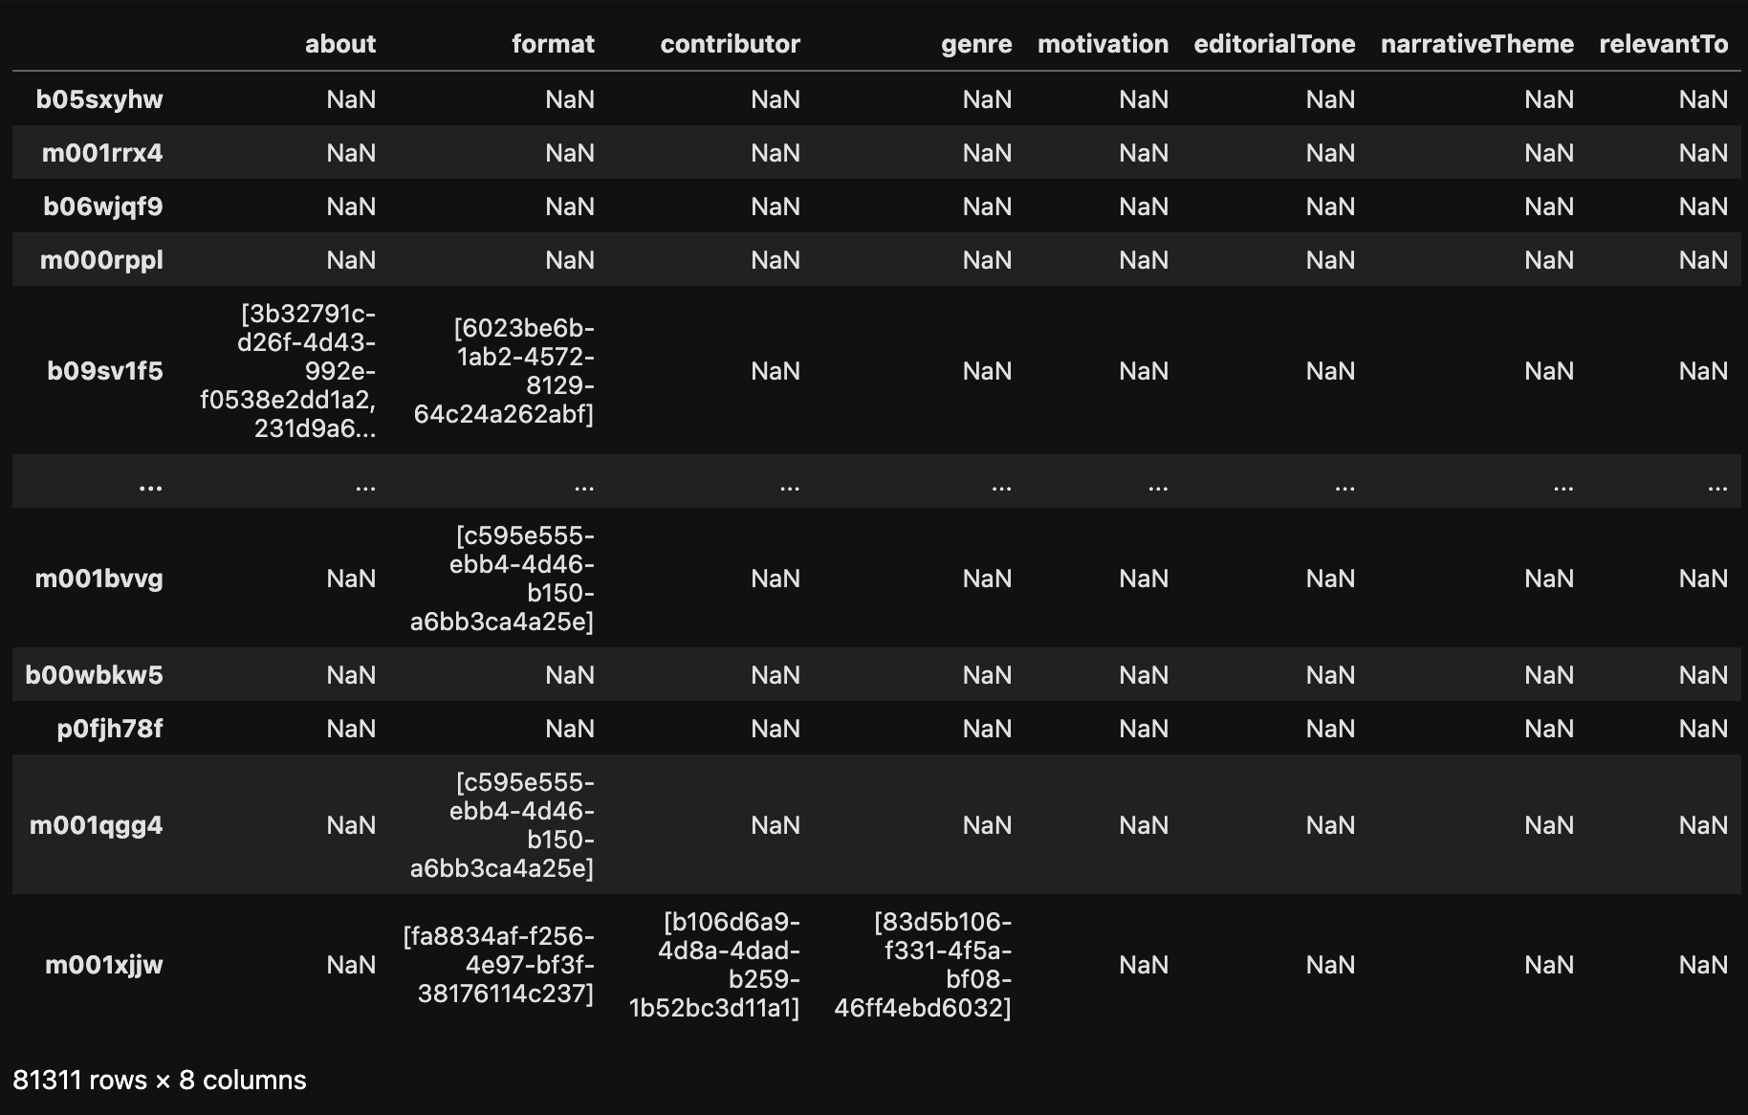
The Data: tradeoff

Slide 47
The Pipeline
Methods, justification, and tools used

Slide 48
The Pipeline
Load
Pre-process
Transform
Generate
Evaluate

Slide 50
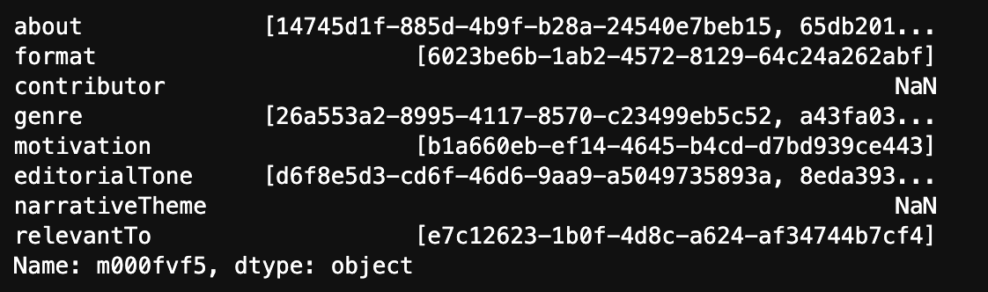
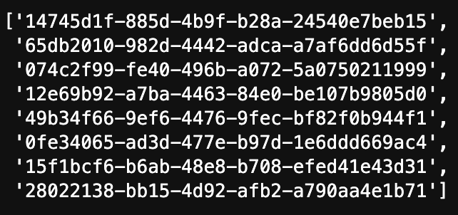

Slide 51
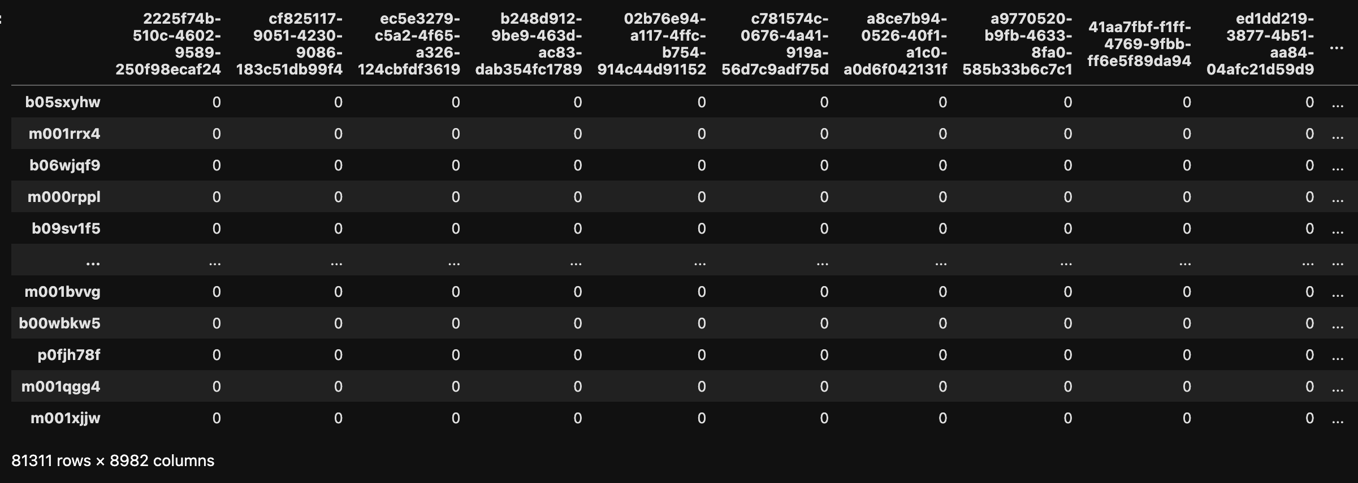
One-hot Encoded Dataset

